Slide 1
Foundations of Special Education
Chris Borgmeier, PhD
Portland State University

Slide 2
Introductions
What has brought you to the field of special education?
What experiences have you had working in Special Education?

Slide 3
www.spedfoundations.pbworks.com

Slide 4
Foundations of Special Education
This course will introduce Special Education teacher candidates to the use of research, theoretical frameworks, professional standards and data as the foundation for guiding decision making and professional practices in special education.
Teacher candidates will be introduced to the “Critical Concepts of Special Education” as identified by faculty of the PSU Special Education Department.

Slide 5
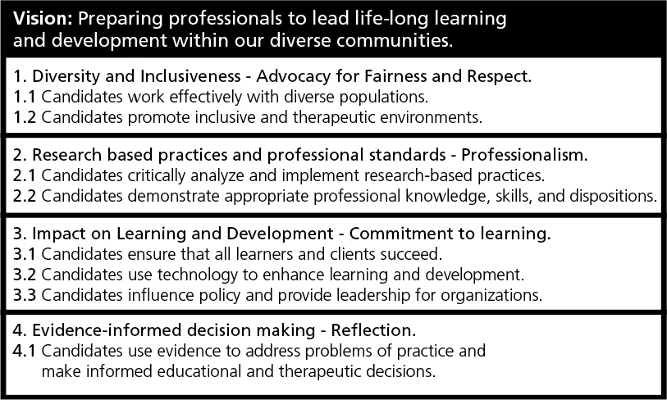
Graduate School of Education Conceptual Framework

Slide 7
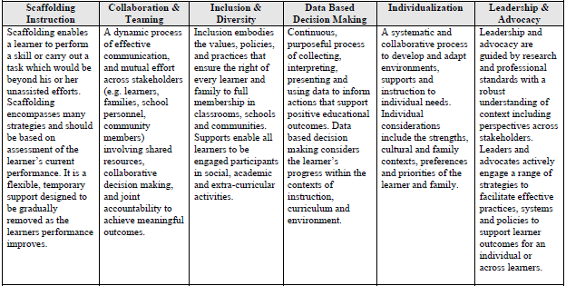
PSU SPED Critical Concepts

Slide 8
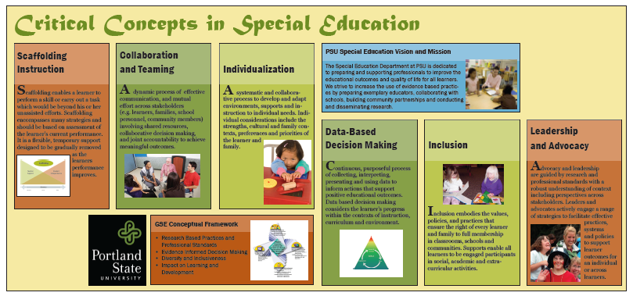

Slide 9
EdTPA Cycle for Effective Teaching

Slide 10
OR TSPC Standards
Standard 1: Foundations: Candidates understand the field as an evolving and changing discipline based on philosophies, evidence-based principles and theories, relevant laws and policies, diverse and historical points of view, and human issues that have historically influenced and continue to influence the field of special education and the education and treatment of individuals with exceptional needs both in school and society.
Candidates:
(A) Understand how these influence professional practice, including assessment, instructional planning, implementation, and program evaluation;
(B) Understand how issues of human diversity can impact families, cultures, and schools, and how these complex human issues can interact with issues in the delivery of special education services;
(C) Understand the relationships of organizations of special education to the organizations and functions of schools, school systems, and other agencies; and
(D) Use this knowledge as a ground upon which to construct their own personal understandings and philosophies of special education.

Slide 11
Across the Range of Learners
Continuum of Supports
Instructional
Behavioral
Assessment drives supports
Same principles… different levels of intensity

Slide 12
Small Group Share
What guides your practice & informs your decisions currently as a Special Educator?
You want to help kids…. What informs HOW you would help a student?

Slide 13
Group Assignments
Identify categories of learners, disability categories or student learning/social/functional challenges you are interested Significant disabilities
Students with Learning disabilities
Students with Emotional & Behavioral Disorders
Students from Culturally & Linguistically Diverse backgrounds
Students with significant disabilities
Students who are non-verbal
Etc.

Slide 14
Group Assignments
Two Tasks:
As a group discuss a student/child you have worked with (within your interest topic area) or heard about for whom you didn’t know what to or how to help the student learn, behave, etc.
As a group agree on 1 type of student/problem & define the problem you want to seek an intervention for
Example: Secondary students (MS/HS) with emotional behavioral problems who engage in work refusal (head down, non-responsive) and won’t do any work.

Slide 15
Assignment #1
Find answers/suggestions so you can begin supporting your new student tomorrow:
Where did you go to for answers/suggestions?
List each source (Websites, books, articles, people)
Website – provide link and brief description of site
Book – citation & brief description
Article – provide citation and link (if available) and brief description
People – who? Job/professional title? Relationship to you?
What did you learn from each source?

